Slide 1
SQL Server Query Store - باللغة العربية
Ayman El-Ghazlai

Slide 2
What does it do?
Stored query plans on disk, keeps history of query plans
Data is persisted on disk, and survives during a crash
Query data is mobile, moves with the database if it is moved to a different server
Captures all queries executed against the database, aggregates the information and flushes it to disk
DATA_FLUSH_INTERVAL_SECONDS – determines how often data is flushed down to disk, similar to how the checkpoint process works

Slide 3
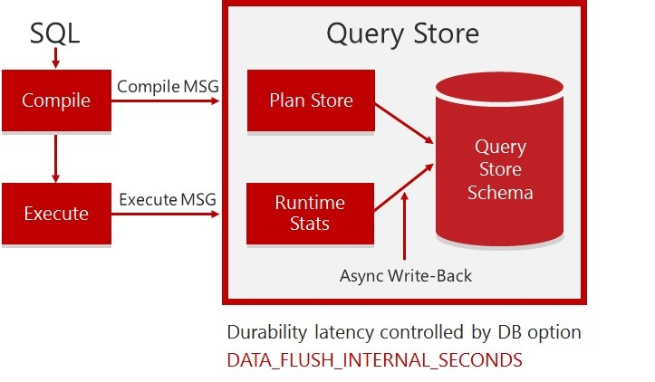
Simplified Architecture
https://msdnshared.blob.core.windows.net/media/2016/03/218.jpg

Slide 4
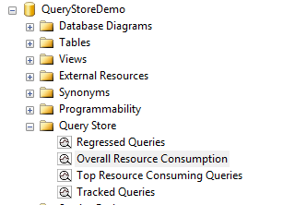
Simplified Reporting
Four build in reports allow for quick analysis of query performance
Built in DMVs allow for further analysis and customizable reports based on data stored internally
Sys.database_query_store_options
Sys.query_store_query
Sys.query_store_query_text
Sys.query_context_settings
Sys.query_store_plan
Sys.query_store_runtime_stats
Sys.query_store_runtime_stats_interval

Slide 5
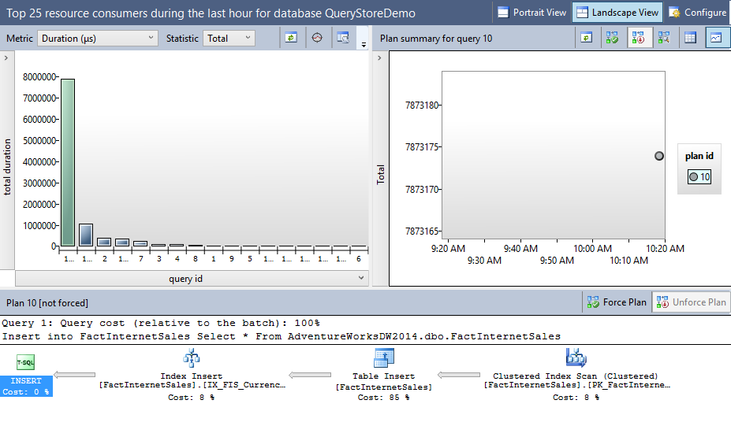
Top 25 Resource Consumers
Simple report designed to display top resource consumers
Can see query text, execution plan, and track queries

Slide 6
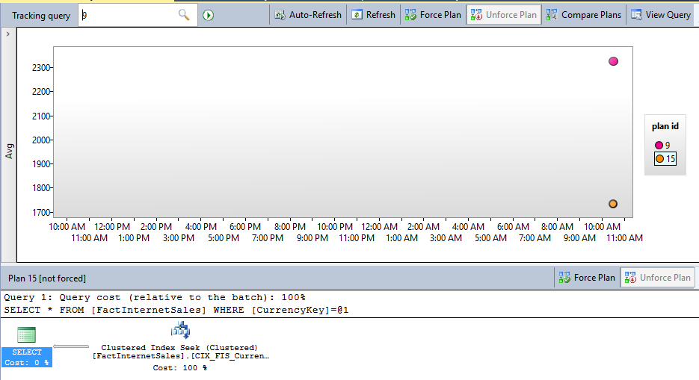
Tracked Queries
Detailed report for specific query
Shows various execution plans used to fulfil query request
Can compare plan performance easily and force plans

Slide 7
Demo

